Slide 1
Interfacing Microcomputer Ports to high power devices
High power devices – lights, motors, solenoids, heaters etc
Programmable port devices can source only a few tenths of a milliampere from the +5V supply and sink only 1 or 2 mA to ground
We need to use interface devices between the port pin and the high power device
Transistor Buffers
Single Transistor circuits can be connected to microprocessor port lines to drive LEDs or small dc lamps
First of all we need to determine whether we want a logic high or a logic low on the output port pin to turn on the device
  Logic High- NPN circuits
  Logic low- PNP circuit
How much current we need to flow through the LED, Lamp or other device
Current Gain of transistor

Slide 2
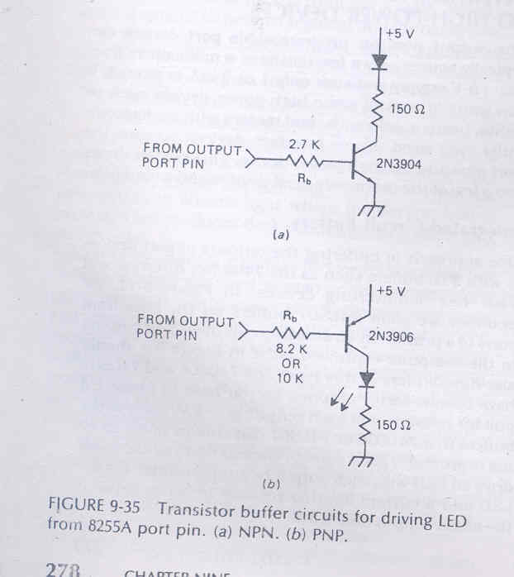
Transistor Buffer
If β=50
We need to produce I_{c}= 20mA
Then I_{b} = 20/50 = 0.4 mA
Then output port pin has to supply 0.4 mA
0.2 mA -> 2.4 V
0.4 mA -> 2 V
R_{b} = (2 – 0.7)/0.4 = 3.25
1.7 mA -> 0.45 V
0.4 mA -> 0.3 V
R_{b} = (4.3– 0.3)/0.4 =10

Slide 3
Darlington pair
If we need to switch currents larger than about 50mA on and off with a output port line, a single transistor does not have enough current gain to do this dependably.
Solution: to connect two transistors in a Darlington Configuration
Usually used to drive small solenoid valve
Output port pin supplies the base current to transistor Q1
This base current produces a collector current β times as large in Q1
Emitter current of Q1– base current of Q2 and is amplified by the current gain of Q2
Device acts like a single transistor-
  Current gain= β Q1 * β Q2
  Base- emitter voltage= (0.7+0.7=1.4v)

Slide 4
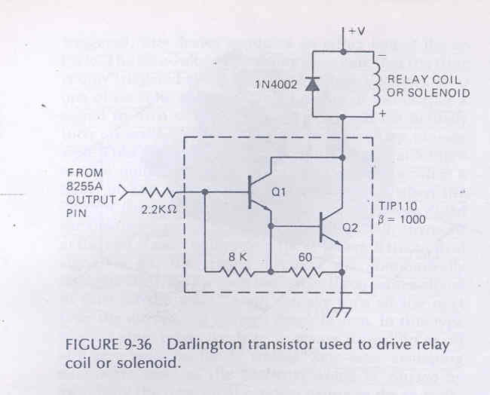

Slide 5
Inductive Kick
A reverse biased diode is connected across the solenoid coil
Basic principle of an inductor – it fights a change in the current through it
When we apply a voltage to the coil by turning on the transistor- it takes a while for the current to start flowing (not a major problem)
When we turn off the transistor – the collapsing magnetic field in the inductor keeps the current flowing for a while
  Cannot flow through the transistor(off)
  Current develop a voltage across the inductor
  This induced voltage is called “inductive kick”
    Usually large enough to break down the transistor
  When the coil is conducting , diode is reverse-biased(it doesn’t conduct)
  When the induced voltage reaches 0.7v – diode turns on & supplies a return path for the induced current
    So the transistor is saved

Slide 6
Interfacing to AC power devices
Relay Control Circuits are Electrically isolated from the actual switch – bakes ICs
Mechanical Relay
  Open and close contacts
  When current passed through coil, switch arm is pulled down.
  Arcing, oxidized, higher resistance, may get hot enough to melt.
  Switch on/off at any point in the AC cycle – cause large noise – EMI(Electromagnetic Interference)
Solid State Relay

Slide 7
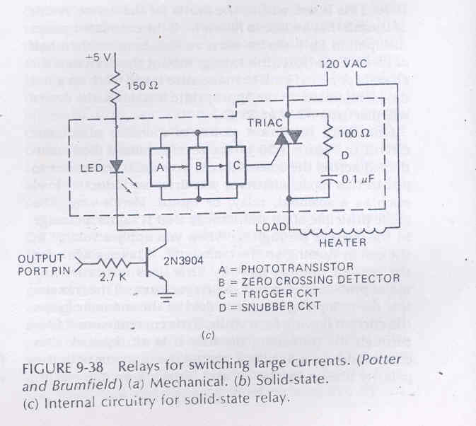

Slide 8
Solid state relay
Advantages
  Less EMI
  No mechanical contact
  Easily driven from microcomputer ports
Disadvantages
  Expensive
  Significant Voltage drop
  Changing voltage across triac for large inductive load.
    RC snubber circuit (To keep the voltage and load current in phase)

Slide 9
Interfacing a microcomputer to a Stepper Motor
Stepper Motor:
A unique type of motor useful for moving things in small increments.
Step Size : 0.9⁰ to 30⁰
Stepper motor is stepped from one position to the next by changing the currents through the fields in the motor.
Two common field connections are
    Two phase
    Four phase
When stepped to a new position- it tends to oscillate around the new position before setting down.
  A common technique to damp out the oscillation
    Send the pattern to step the motor toward the new position
    When motor has rotated part of the way to the new position, a word to step the motor backward is output for a short time
    The step-forward word is then sent again to complete the step to the new position
    Timing of damping command must be determined experimentally

Slide 10
Diode must be added across each winding, to save the transistors from Inductive kick.
Nominal voltage rating of motor 5.5V
Voltage drop across transistor 1V
Total 6.5V(would work fine for low stepping rates)
For high stepping rates
    Higher supply voltage
    Current limiting resistors
  This allows the currents in the windings to change more rapidly
  Current per winding 0.88 A, only one winding on each resistor is ever on at a time
  Thus 6.5/0.88 gives resistor value 7.4 Ω

Slide 11
How we can cut the power Dissipation
When the motor is not stepping , switch to +12V is off, so the motor is held in position by the current from the +5V supply
Before sending a step command we need to turn on the transistor to +12V to give the motor more current for stepping.
When stepping is done
  Turn off the switch to +12V
  Drop back to +5V supply

Slide 12
